Slide 1
NTT quantum circuit for CRYSTALS–Kyber
Gyeongju Song
Notes:
Hello, my name is 경주 송.
My presentation topic is NTT quantum circuit for CRYSTALS-Kyber

Slide 2
Contents
Introduction
Related work
Proposed method
Conclusion

Slide 3
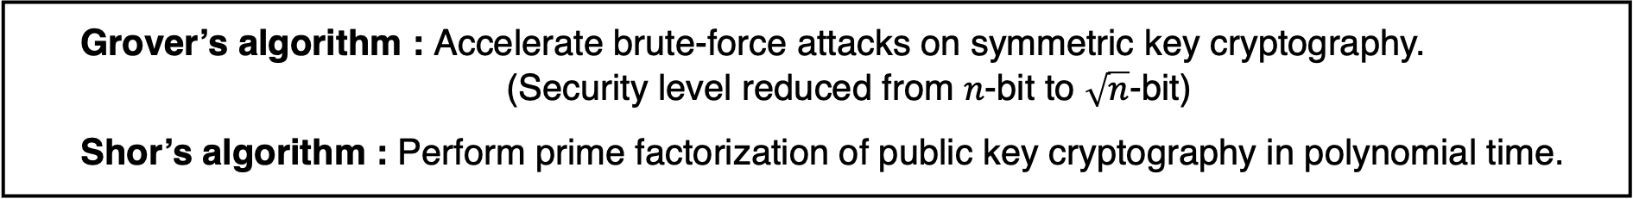
Introduction
The advent of large-scale quantum computers is expected to pose a threat to the current cryptosystem.
When the available resources of a quantum computer reach the resources required for a cryptographic attack, it is expected that the target Cryptography will be broken.
→ Therefore, it is expected that existing cryptosystems will be replaced by Post-Quantum Cryptography (PQC) algorithms.
Grover’s algorithm : Accelerate brute-force attacks on symmetric key cryptography.
(Security level reduced from $n$-bit to $\sqrt{n}$-bit)
Shor’s algorithm : Perform prime factorization of public key cryptography in polynomial time.

Slide 4
Introduction
The National Institute of Standards and Technology (NIST) conducted standardize PQC algorithms to replace the existing cryptosystem in preparation for the post-quantum era.
<Alternates>
<Finalists>
Nation | Algorithm | Base problem | Function
North America | FrodoKEM | 격자 | PKE/KEM
 | NTRU-Prime
 | SIKE | Isogeny
Europe | HQC | Code
 | BIKE
 | GeMMS | Multivariate | Digital Signatures
 | SPHINCS+ | Hash | 전자서명
 | Picnic | Zero-knowledge proof
Nation | Algorithm | Base problem | Function
North America | NTRU | Lattice | PKE/KEM
 | Rainbow | Multivariate | Digital Signatures
Europe | CRYSTALS-KYBER | Lattice | PKE/KEM
 | SABER
 | Classic McEliece | Code
 | CRYSTALS-DILITHIUM | Lattice | Digital Signatures
 | FALCON

Slide 5
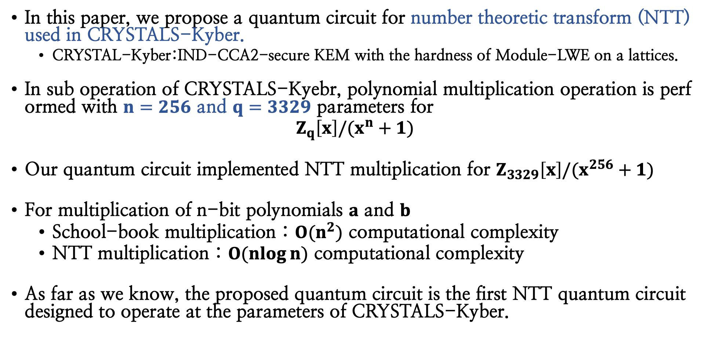
Introduction
In this paper, we propose a quantum circuit for number theoretic transform (NTT) used in CRYSTALS-Kyber.
CRYSTAL-Kyber:IND-CCA2-secure KEM with the hardness of Module-LWE on a lattices.
In sub operation of CRYSTALS-Kyebr, polynomial multiplication operation is performed with $n=256$ and $q=3329$ parameters for
$$Z_{q}\left[x\right]/(x^{n}+1)$$
Our quantum circuit implemented NTT multiplication for $Z_{3329}\left[x\right]/(x^{256}+1)$
For multiplication of n-bit polynomials $a$ and $b$
School-book multiplication : $O(n^{2})$ computational complexity
NTT multiplication : $O(\operatorname{nlog}{n)}$ computational complexity
As far as we know, the proposed quantum circuit is the first NTT quantum circuit designed to operate at the parameters of CRYSTALS-Kyber.

Slide 6

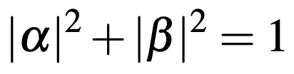
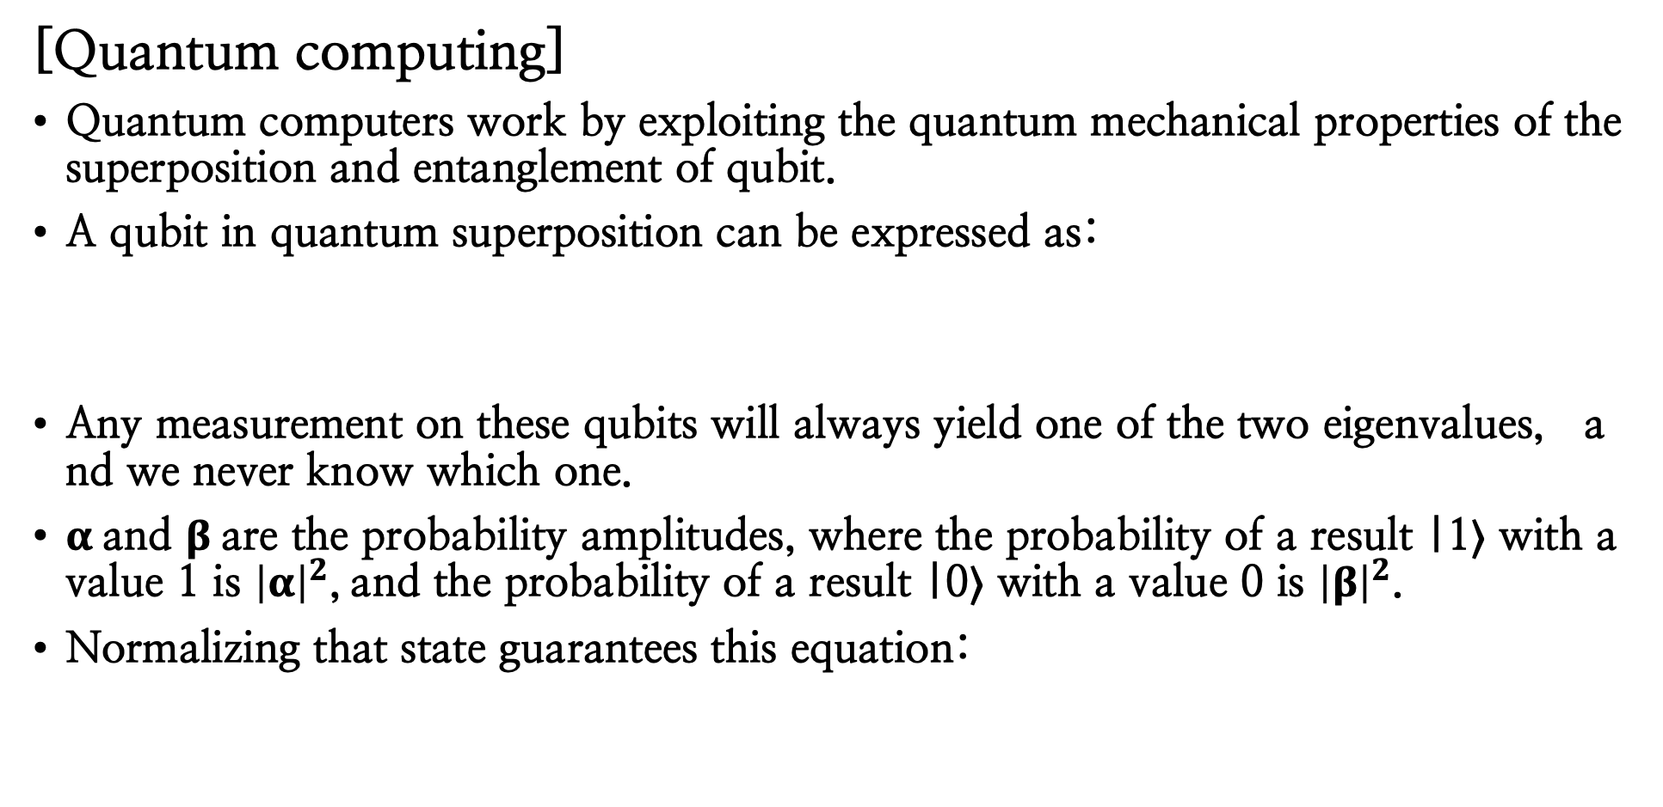
Related work
[Quantum computing]
Quantum computers work by exploiting the quantum mechanical properties of the superposition and entanglement of qubit.
A qubit in quantum superposition can be expressed as:
Any measurement on these qubits will always yield one of the two eigenvalues, and we never know which one.
$α$ and $β$ are the probability amplitudes, where the probability of a result |1⟩ with a value 1 is ${\left|α\right|}^{2}$, and the probability of a result |0⟩ with a value 0 is ${\left|β\right|}^{2}$.
Normalizing that state guarantees this equation:

Slide 7
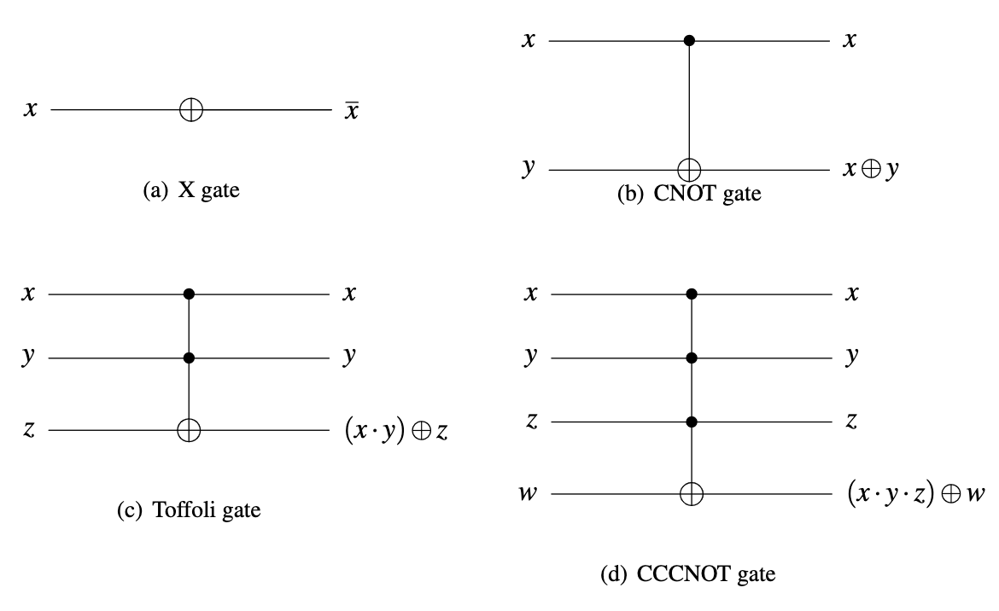
Related work
Quantum gate
The state of a qubit is changed through a quantum gate.
The quantum gates used in this paper are as follows:
X gate:
The X gate operates with a single qubit and reversed the input state.
(b) CNOT gate:
In CNOT gate, the state of the target qubit y is reversed only when the control qubit x is one.
(c) Toffoli gate:
In Toffoli gate, the state of the target qubit z is reversed only when the control qubits x and y are both one.
(d) CCCNOT gate (3 qubit multi-controlled gate):
In CCCNOT gate, the state of the target qubit w is reversed only when the control qubits x to z are all one.

Slide 8

Related work
[CRYSTALS-Kyber]
CRYSTALS-Kyber is an IND-CCA2-secure KEM with the hardness of Modul-LWE on a lattices.
The Kyber cipher, designed to be robust in the post-quantum era, is one of the finalists of the post-quantum cryptography project conducted by NIST.
Security is based on the hardness of resolving learning-with-errors (LWE) problems for module lattices.

Slide 9
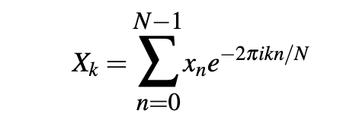
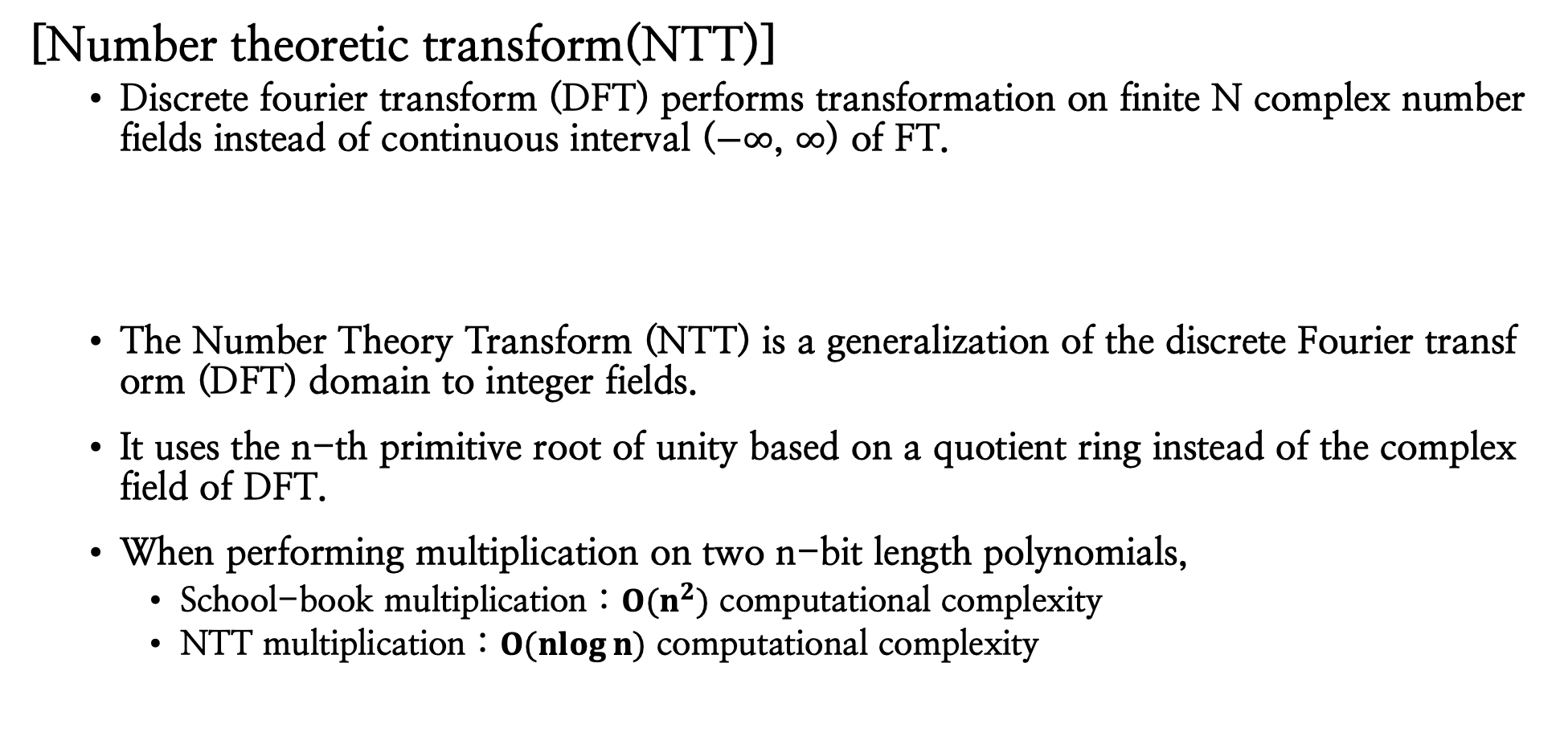
Related work
[Number theoretic transform(NTT)]
Discrete fourier transform (DFT) performs transformation on finite N complex number fields instead of continuous interval ($−∞$, $∞$) of FT.
The Number Theory Transform (NTT) is a generalization of the discrete Fourier transform (DFT) domain to integer fields.
It uses the n-th primitive root of unity based on a quotient ring instead of the complex field of DFT.
When performing multiplication on two n-bit length polynomials,
School-book multiplication : $O(n^{2})$ computational complexity
NTT multiplication : $O(\operatorname{nlog}{n)}$ computational complexity

Slide 10
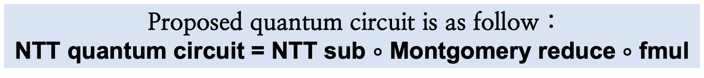
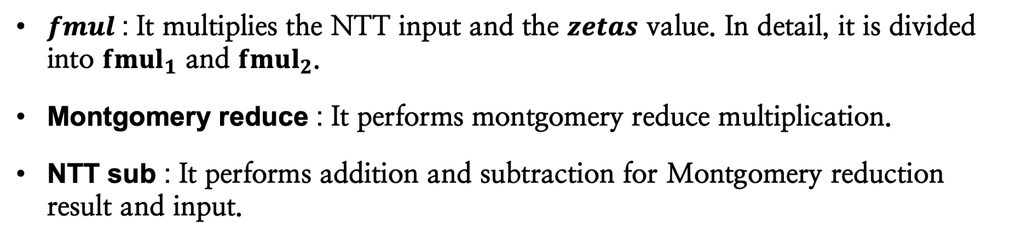
Proposed method – NTT quantum circuit for CRYSTALS-Kyber
This paper propose a quantum circuit for NTT multiplication used in a lattice-based algorithm.
CRYSTALS-Kyber NTT parameter : $Z_{3329}\left[X\right]/(X^{356}+1)$
Proposed quantum circuit is as follow :
NTT quantum circuit = NTT sub $∘$ Montgomery reduce $∘$ fmul
$fmul$: It multiplies the NTT input and the $zetas$ value. In detail, it is divided into ${fmul}_{1}$ and ${fmul}_{2}$.
Montgomery reduce : It performs montgomery reduce multiplication.
NTT sub : It performs addition and subtraction for Montgomery reduction result and input.

Slide 11
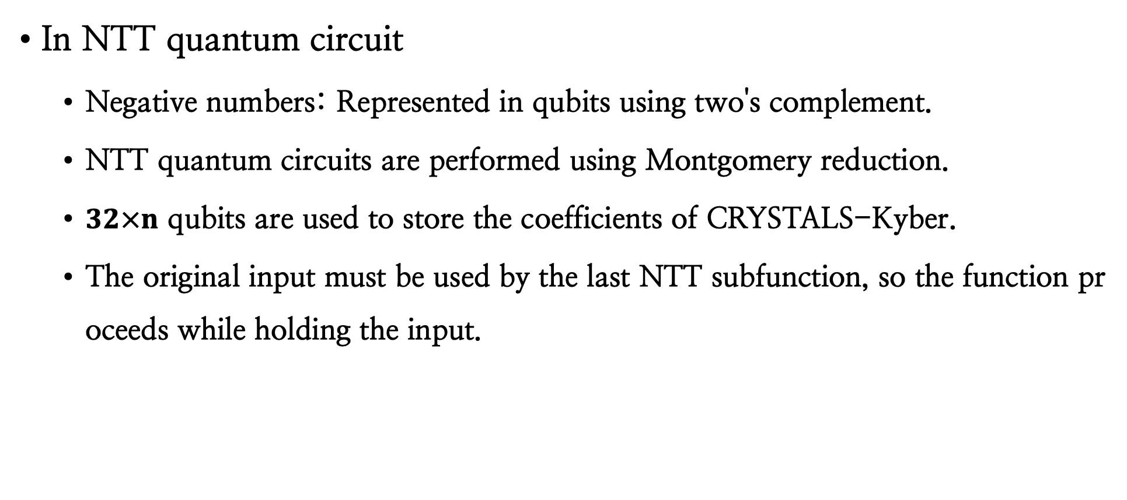
NTT quantum circuit for CRYSTALS-Kyber
In NTT quantum circuit
Negative numbers: Represented in qubits using two's complement.
NTT quantum circuits are performed using Montgomery reduction.
$32×n$ qubits are used to store the coefficients of CRYSTALS-Kyber.
The original input must be used by the last NTT subfunction, so the function proceeds while holding the input.

Slide 12
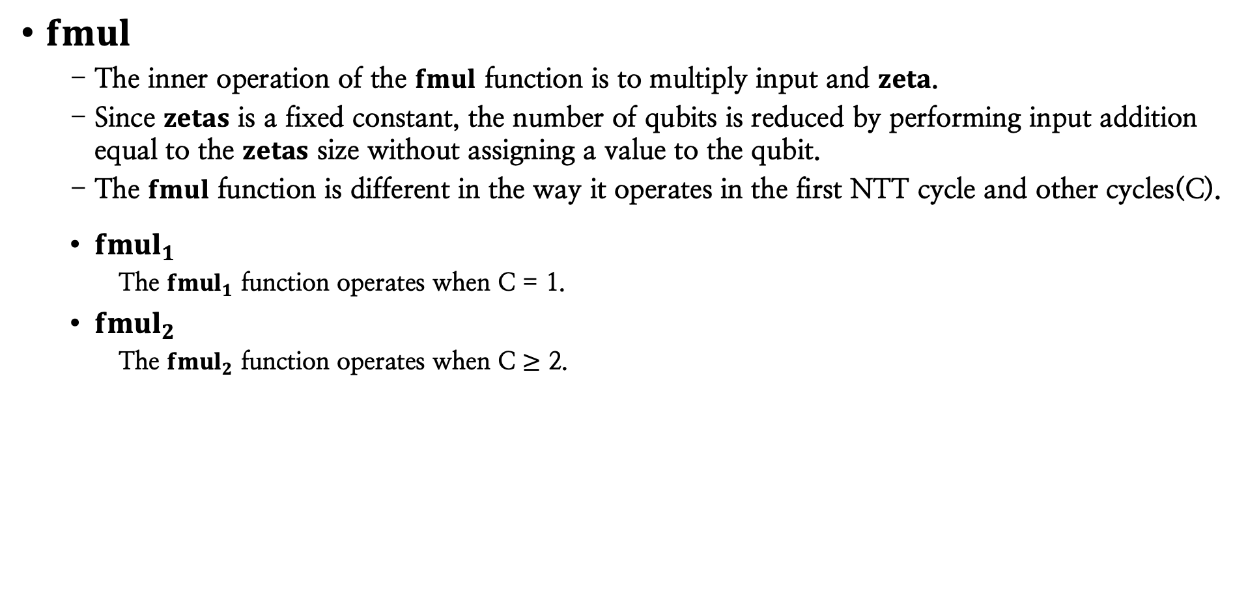
NTT quantum circuit for CRYSTALS-Kyber
$fmul$
The inner operation of the $fmul$ function is to multiply input and $zeta$.
Since $zetas$ is a fixed constant, the number of qubits is reduced by performing input addition equal to the $zetas$ size without assigning a value to the qubit.
The $fmul$ function is different in the way it operates in the first NTT cycle and other cycles(C).
${fmul}_{1}$
The ${fmul}_{1}$ function operates when C = 1.
${fmul}_{2}$
The ${fmul}_{2}$ function operates when C $≥$ 2.

Slide 13
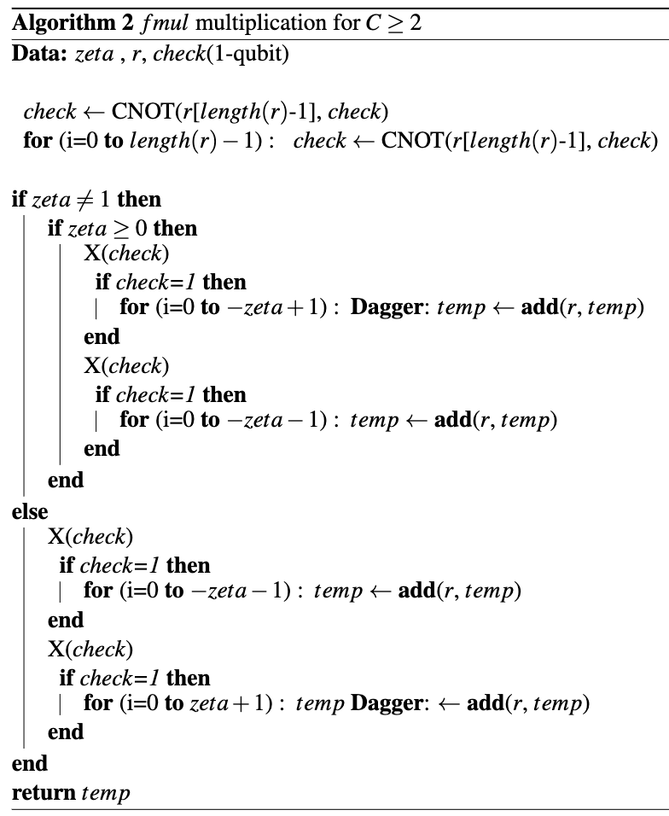
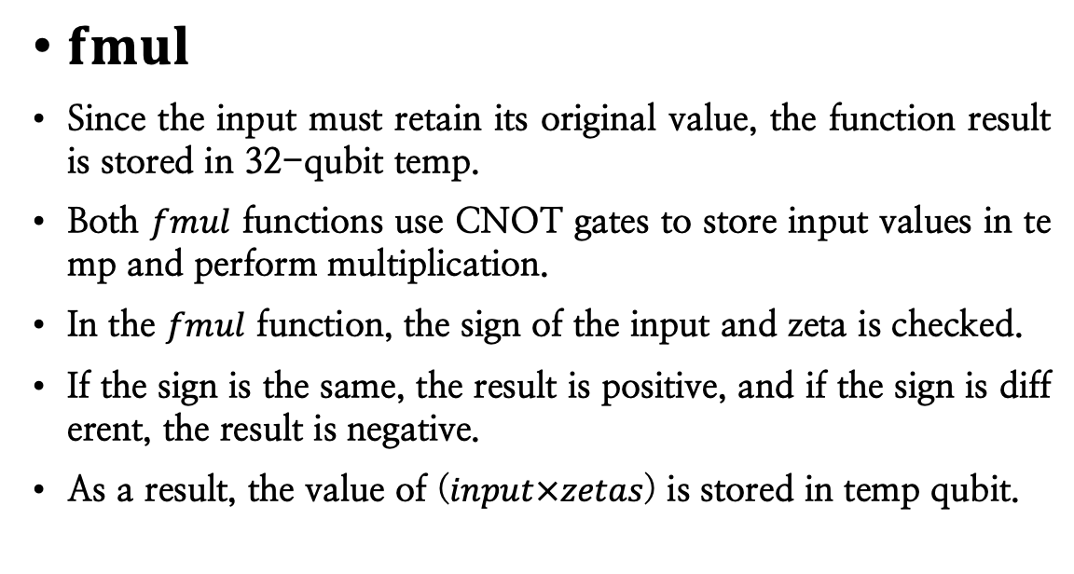
NTT quantum circuit for CRYSTALS-Kyber
$fmul$
Since the input must retain its original value, the function result is stored in 32-qubit temp.
Both $fmul$ functions use CNOT gates to store input values in temp and perform multiplication.
In the $fmul$ function, the sign of the input and zeta is checked.
If the sign is the same, the result is positive, and if the sign is different, the result is negative.
As a result, the value of ($input×zetas$) is stored in temp qubit.

Slide 14
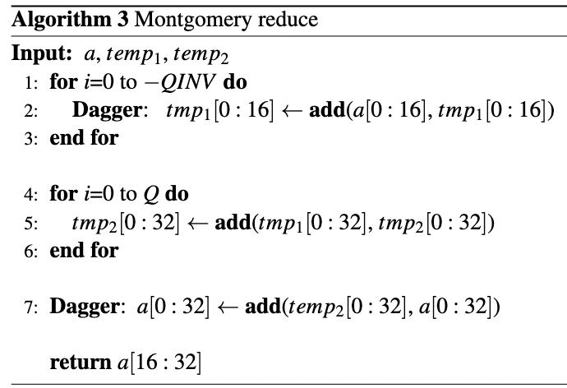


NTT quantum circuit for CRYSTALS-Kyber
Montgomery reduce
This function performs montgomery reduction multiplication on the $input×zeta$.
Algorithm 3 shows the operation of the Montgomery reduce quantum circuit.
In the for loop, $Q$ is q = 3329 and $QINV$ is the inverse of $Q$ mod $R$ (= 216) : −3327.
Since $Q$ and $QINV$ are known values, the result of multiplying by the corresponding size is obtained without allocating qubits to store the values of $Q$ and $QINV$.
Finally, index values [0] to [15] are discarded through 16-bit left shift and the values of indexes [16] to [31] are returned.

Slide 15
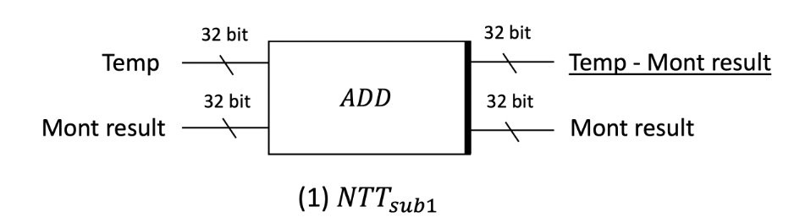
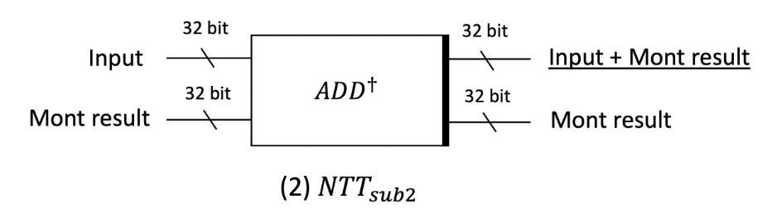
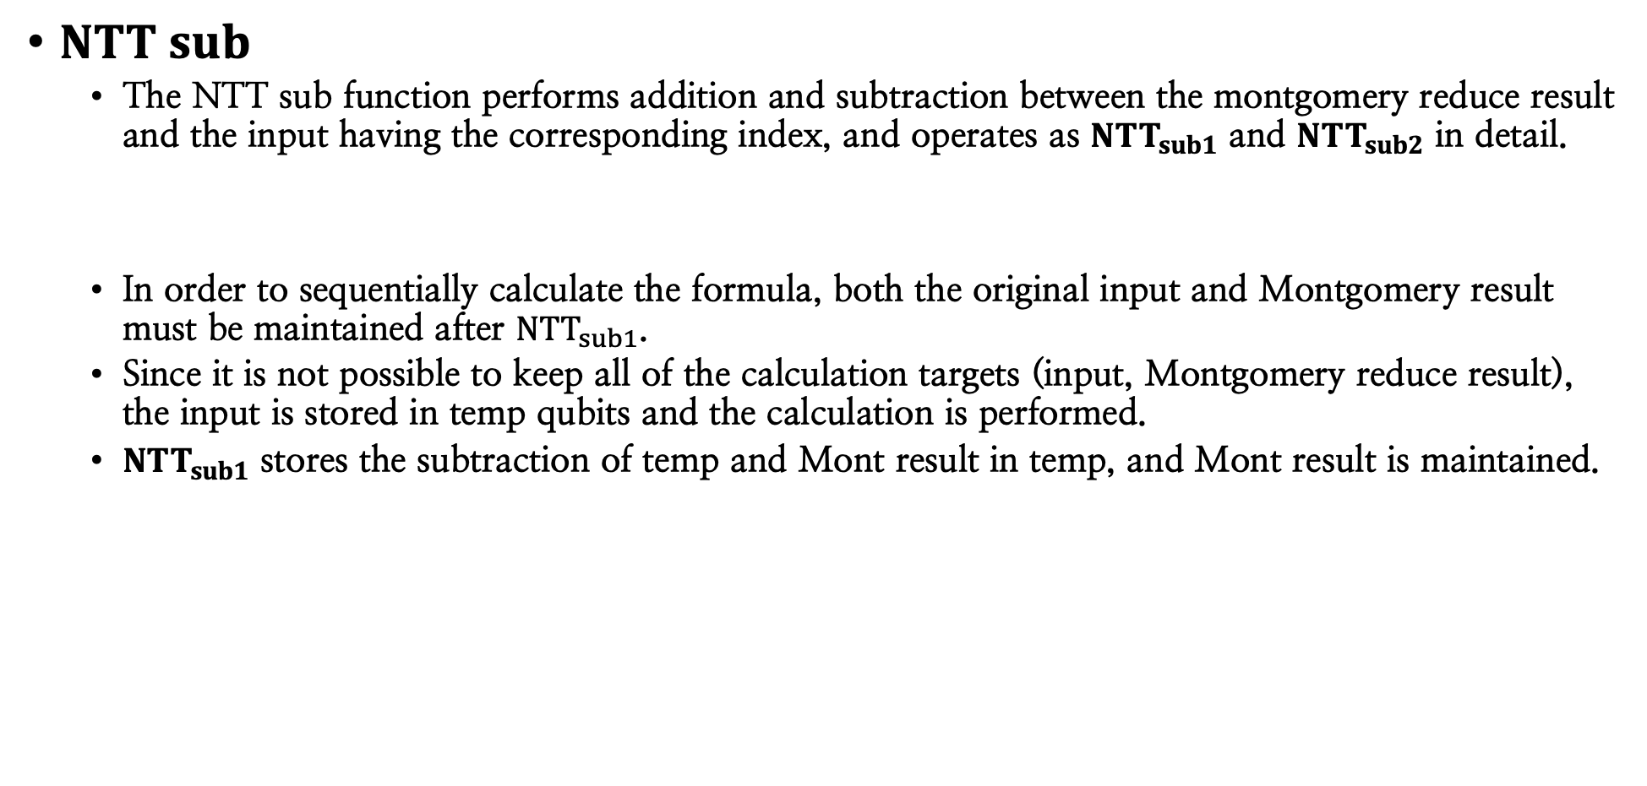

NTT quantum circuit for CRYSTALS-Kyber
$NTT sub$
The NTT sub function performs addition and subtraction between the montgomery reduce result and the input having the corresponding index, and operates as ${NTT}_{sub1}$ and ${NTT}_{sub2}$ in detail.
In order to sequentially calculate the formula, both the original input and Montgomery result must be maintained after ${NTT}_{sub1}$.
Since it is not possible to keep all of the calculation targets (input, Montgomery reduce result), the input is stored in temp qubits and the calculation is performed.
${NTT}_{sub1}$ stores the subtraction of temp and Mont result in temp, and Mont result is maintained.
$${NTT}_{sub1}=input−Montgomery result$$

Slide 16


NTT quantum circuit for CRYSTALS-Kyber
$NTT sub$
${NTT}_{sub2}$ stores the addition of input and Mont result in input.
The results of all operations are sorted according to the NTT array index order.
$${NTT}_{sub2}=input+Montgomery result$$

Slide 17
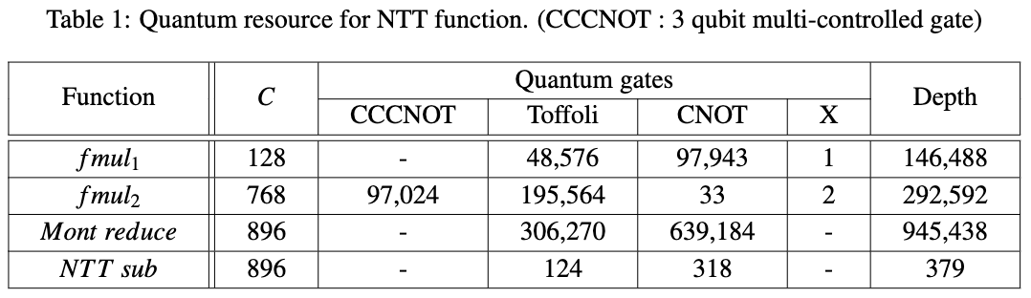
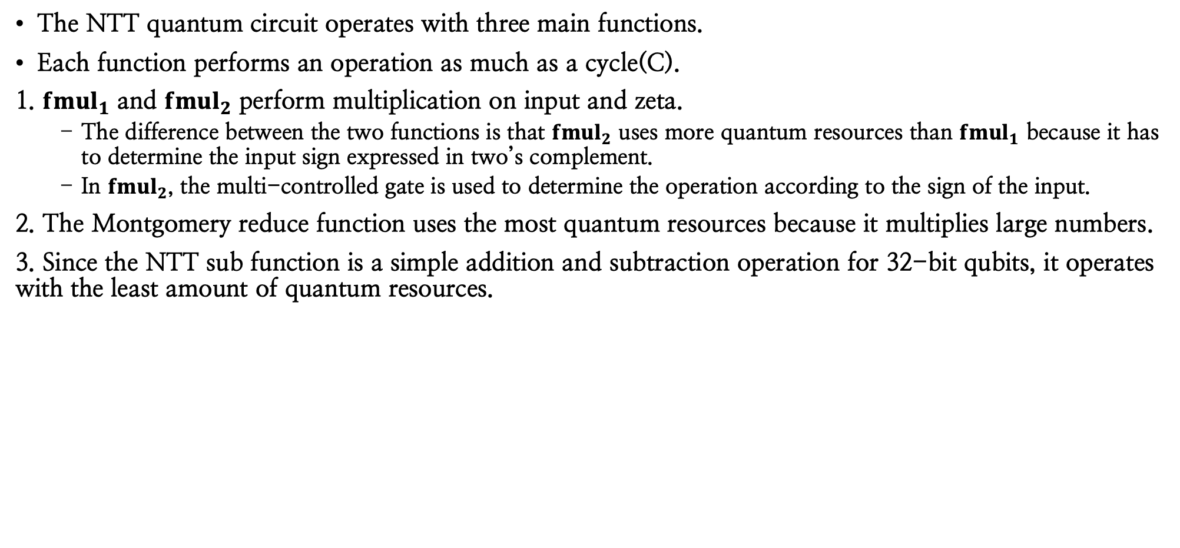
Evaluation
Development environment: ProjectQ, a quantum programming tool provided by IBM
Quantum resource estimation : ResourceSimulation provided by ProjectQ
The NTT quantum circuit operates with three main functions.
Each function performs an operation as much as a cycle(C).
1. ${fmul}_{1}$ and ${fmul}_{2}$ perform multiplication on input and zeta.
The difference between the two functions is that ${fmul}_{2}$ uses more quantum resources than ${fmul}_{1}$ because it has to determine the input sign expressed in two’s complement.
In ${fmul}_{2}$, the multi-controlled gate is used to determine the operation according to the sign of the input.
2. The Montgomery reduce function uses the most quantum resources because it multiplies large numbers.
3. Since the NTT sub function is a simple addition and subtraction operation for 32-bit qubits, it operates with the least amount of quantum resources.

Slide 18
Conclusion
In this paper, we propose a quantum circuit for NTT multiplication that is used to speed up polynomial multiplication in CRYSTALS-Kyber.
The proposed quantum circuit was implemented as an optimization method to reduce quantum resources.
We presented the quantum circuit pseudocode for NTT quantum computing and explained the operation of each function.
Finally, we estimated quantum resources based on the proposed quantum circuit and analyze it.
To the best of our knowledge, this is the first NTT quantum circuit to operate on the CRYSTALS-Kyber cryptographic algorithm.
We expect that it can be used to evaluate the post-quantum security strength for CRYSTALS- Kyber.

Slide 19
Thank you :-)
E-mail : thdrudwn98@gamil.com

